Slide 1
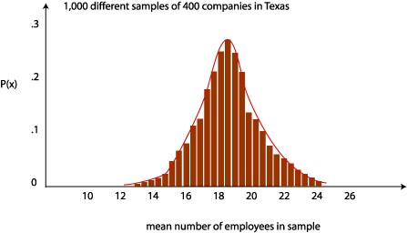
Week 6: Central limit theorem and CIs
Geog4300: Shannon

Slide 2
This week
Central limit theorem
Confidence intervals
Sampling

Slide 3
Let’s roll!
Roll your dice 10 times. Put the results on this page:
https://bit.ly/geog4300_dice
Then do two more sets of 10 rolls (30 total rolls)

Slide 4

The central limit theorem:
What’s the relationship between the mean of the sample population (your dice rolls) and the actual population (all possible rolls)?

Slide 5
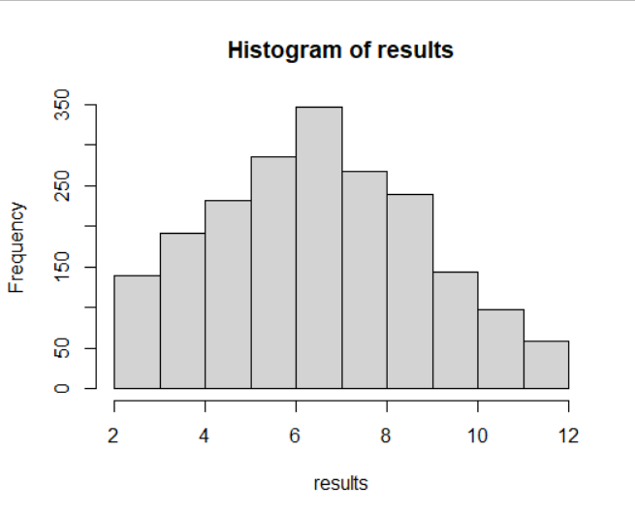
What’s the population?
Mean of two dice rolls: 7
Standard deviation: 2.4
How did your three “samples” compare?
Histogram of results from 2,000 simulated two dice rolls.

Slide 6
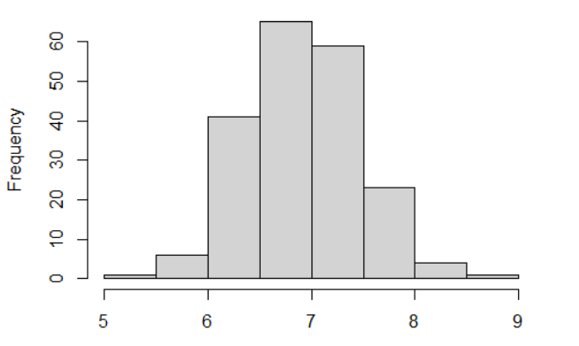
The sample mean distribution
What is the distribution of all possible sample means?
Histogram of means from 200 simulations of 20 two-dice rolls.
Mean of these means: 7
Standard deviation of these means: 0.55

Slide 7

Sample mean distribution: Important when the actual mean is unknown.
The actual mean is here somewhere!

Slide 8

Standard error
$$σ_{\overline{x}}=\frac{σ}{\sqrt{n}}$$
Histogram of means from 200 simulations of 20 two-dice rolls.
Mean of these means: 7
Standard deviation of these means: 0.55

Slide 9

Standard error
$$σ_{\overline{x}}=\frac{σ}{\sqrt{n}}$$
How many 10 dice roll samples did we create? What should our standard error be?
How many means fit within 1 standard error of the mean? Within 2 standard errors?
$σ$=standard deviation of sample or population

Slide 10
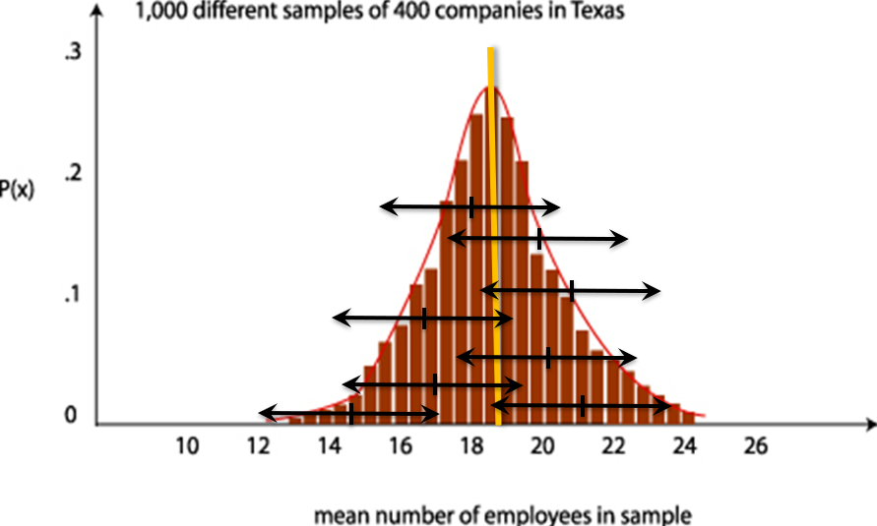
Confidence intervals

Slide 11

Confidence intervals
Three ingredients for a confidence interval:
Sample mean
Standard error
Z-score for the confidence interval
Margin of error = z-score * the standard error
Subtract and add this MOE to the sample mean
What’s the confidence interval for each of your three dice roll samples? How many include the actual mean of 7?
$$σ_{\overline{x}}=\frac{σ}{\sqrt{n}}$$

Slide 12
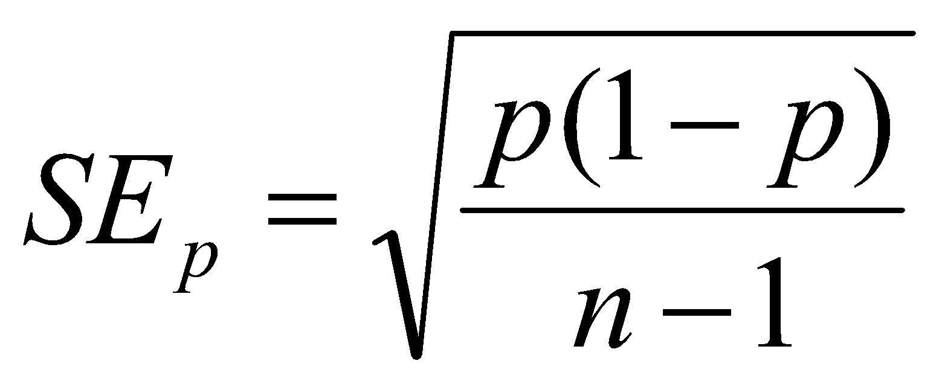
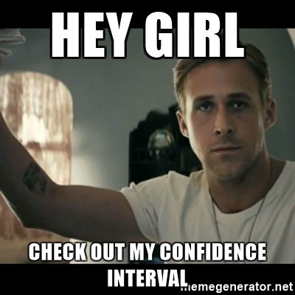
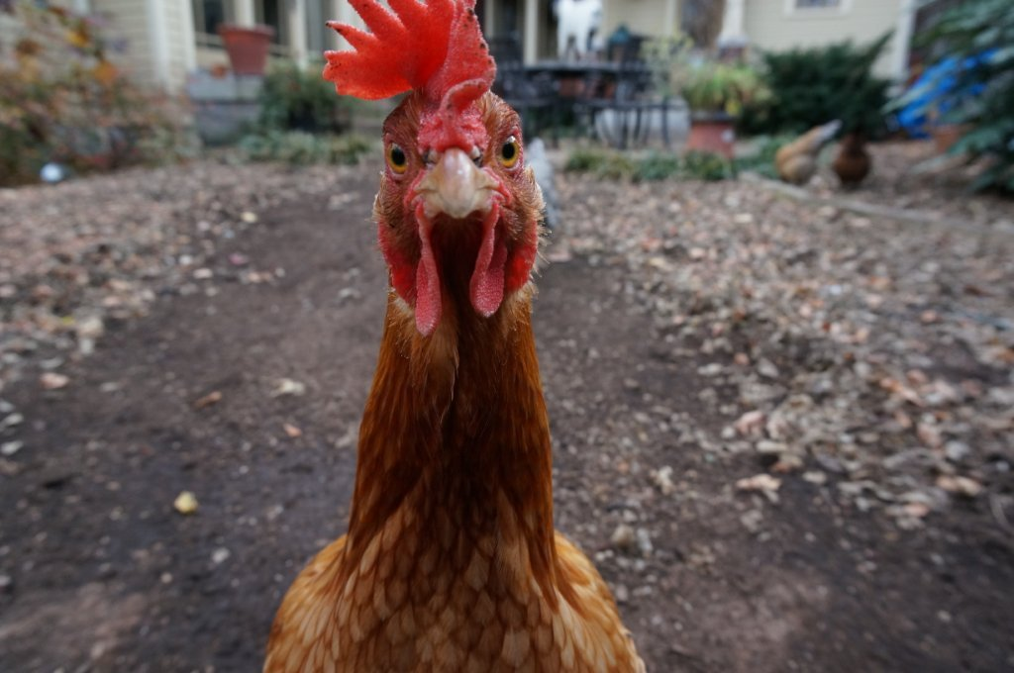
Confidence intervals for proportions
You asked 50 households in Athens if they keep chickens on their property. Three said they did. Create a confidence interval for the proportion of chicken owning households in the city.

Slide 13
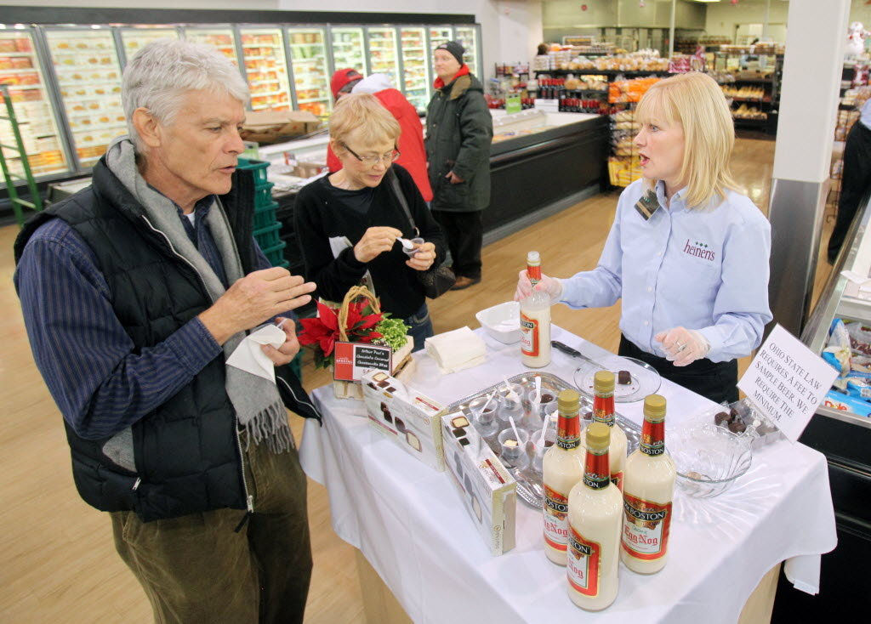
Let’s talk about sampling!

Slide 14

Sample research question:
What are the most significant obstacles homeowners face in maintaining their homes? How does this vary by the homeowners’ age?

Slide 15
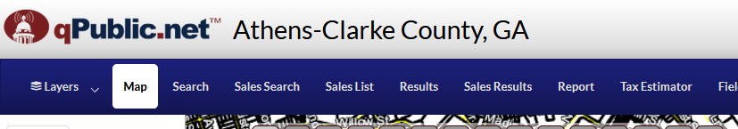
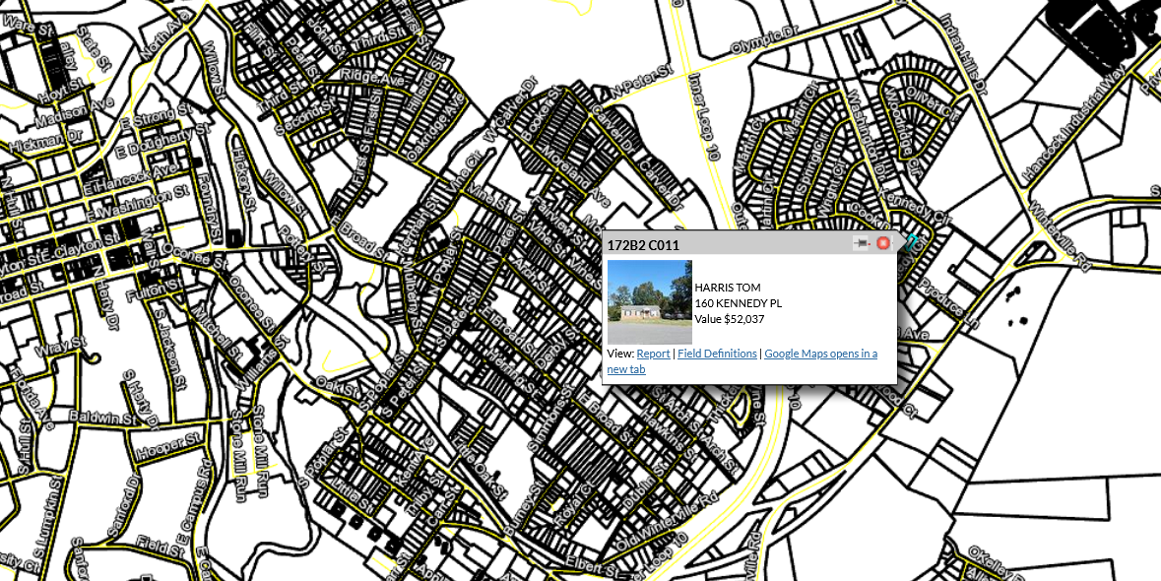
Sampling frame:
List of ALL possible households you could interview

Slide 16
Non-probability sample Convenience
Snowball
Quota
Probability sample
Random
Systematic
Stratified
Cluster
Individually: Do some online research. What’s this sampling strategy about?
In groups: What would it look like for our research question on home owners?

Slide 17

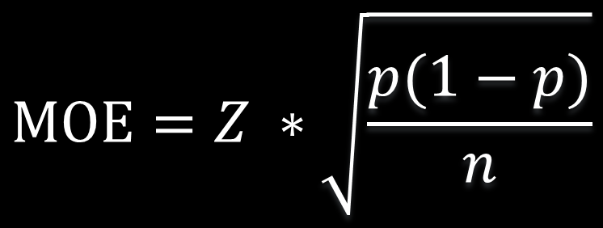
Sample size
$$MOE=Z ∗\sqrt{\frac{p(1−p)}{n}}$$
If the MOE for proportions is
Then we can compute sample size as
$$n=\frac{Z^{2}}{{MOE}^{2}}∗(p ∗\left(1−p\right))$$
We asked 20 homeowners if they were worried about losing their homes in the next year. Four said yes. What’s the confidence interval?
How big a sample would we need to get a margin of error < 1.5%

